Slide 1

Architect
Lucas Ressler

Slide 2

Tasks
Designing & planning buildings
Giving advises
controlling the process of building

Slide 3
Education
Bachelor & Master studies for architecture

Slide 4
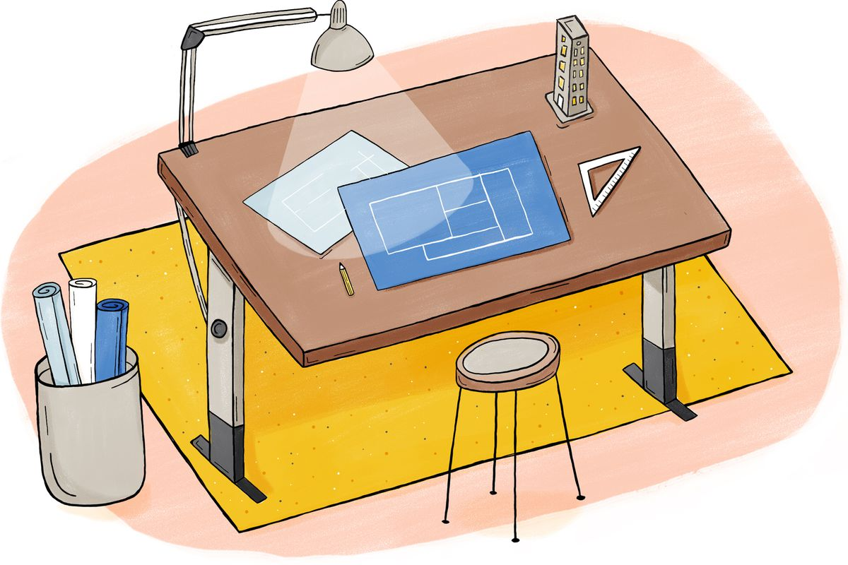
Working place
Home
Office
Building lot

Slide 5

Working clothes
Helmet
High-visibility jacket

Slide 6
Working hours
Fixed working times of 8-9 hours at a business concern

Slide 7

Income
Starting income: 2000-2500 €
Average income: 2600-4400 €

Slide 8
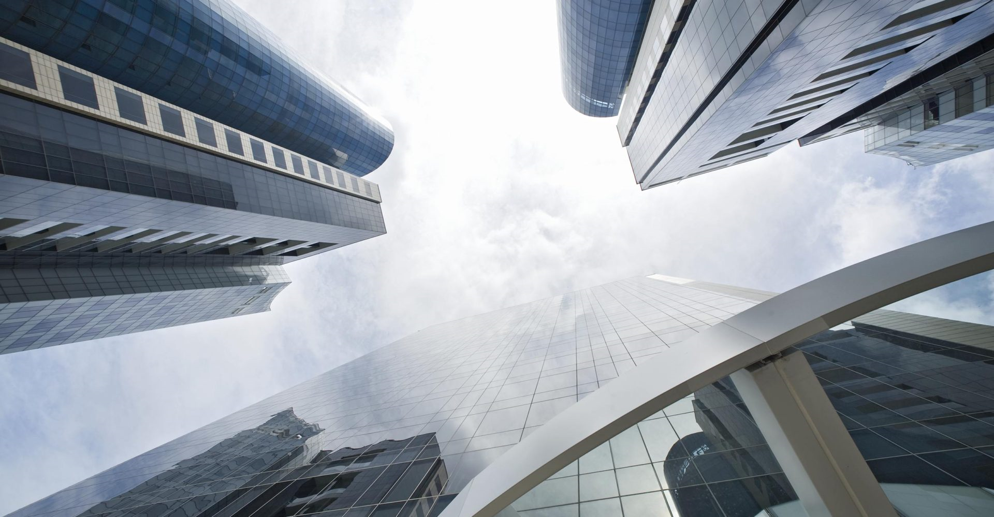
Thank you for your attention!

